Slide 1



Team Atlantis – “Dodgy Dealing” Engine (with DeepDive)
Charles Cai
Hacker
Marek Labos
Hacker
Johnny Chan
Hacker
#MODHack | 25-27 September 2015 | WallaceSpace, London

Slide 2

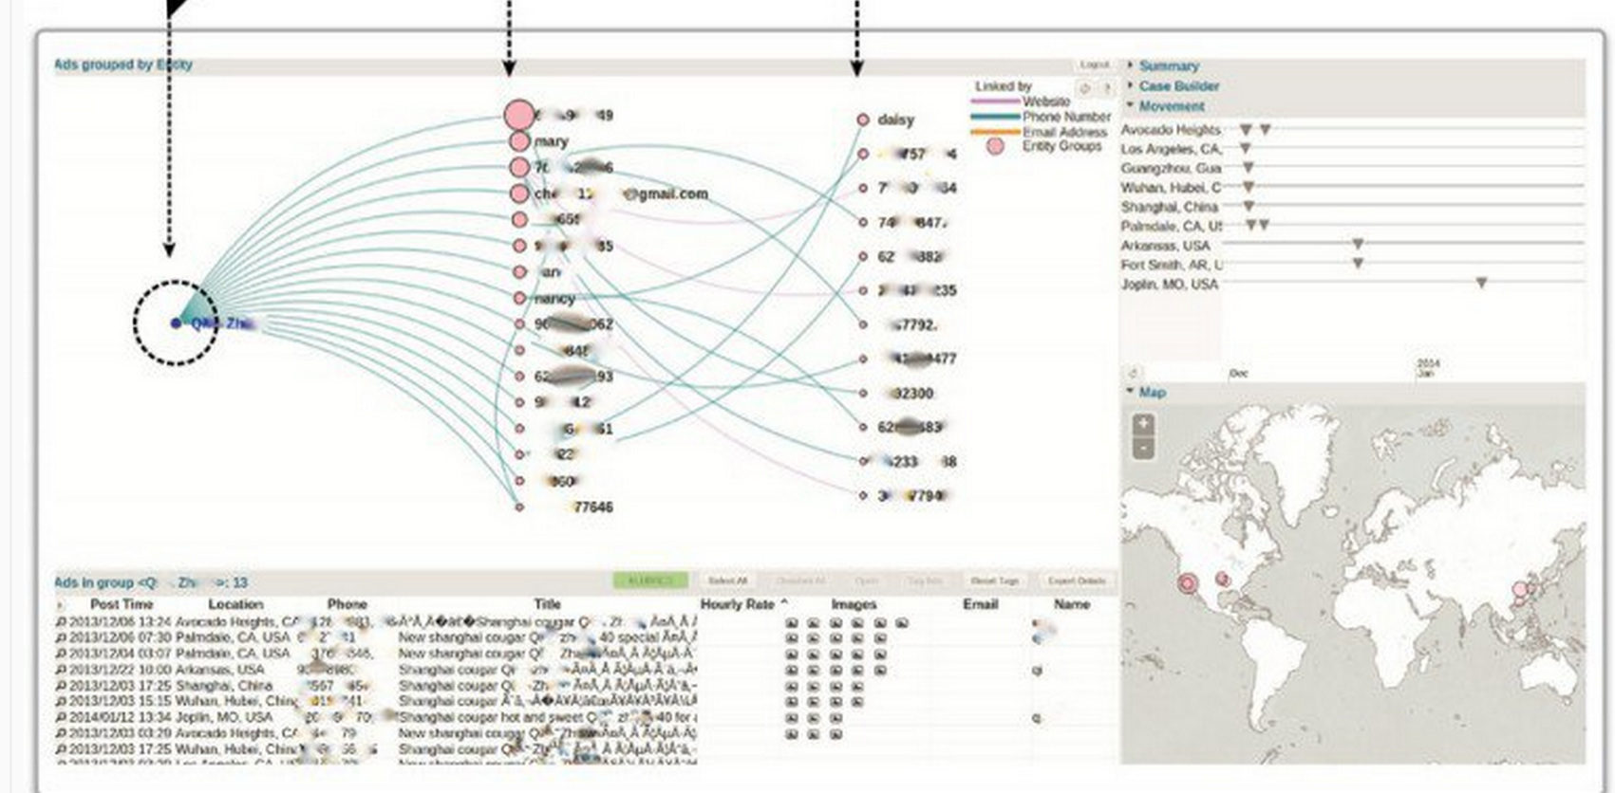
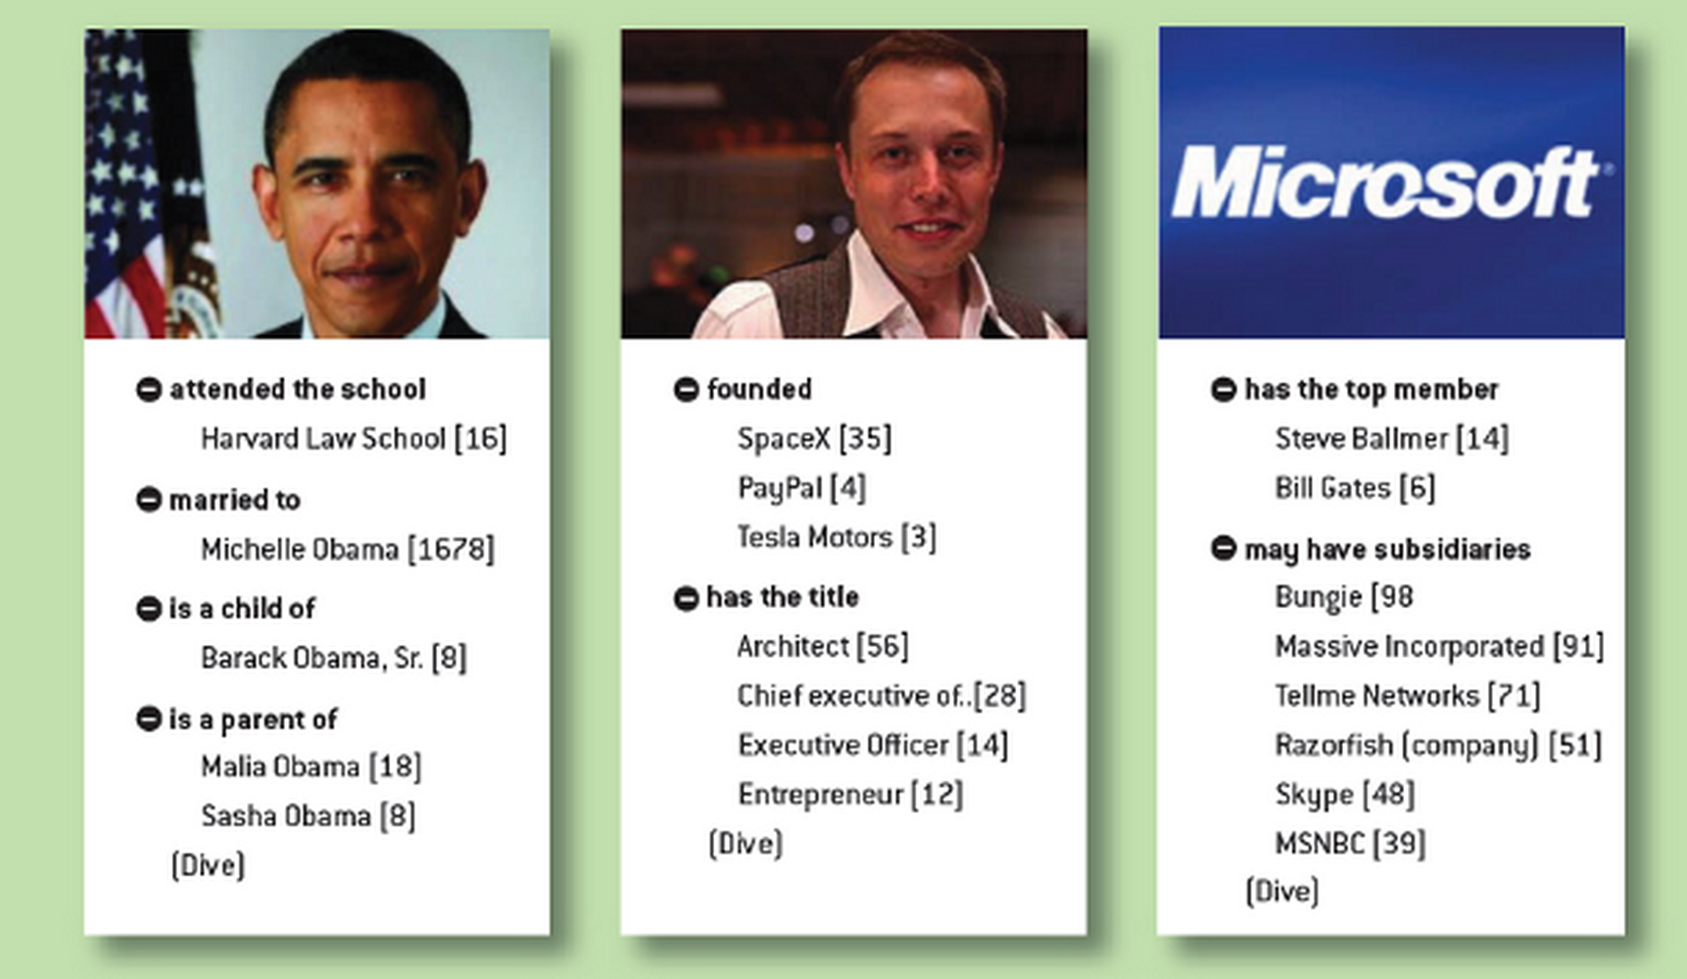
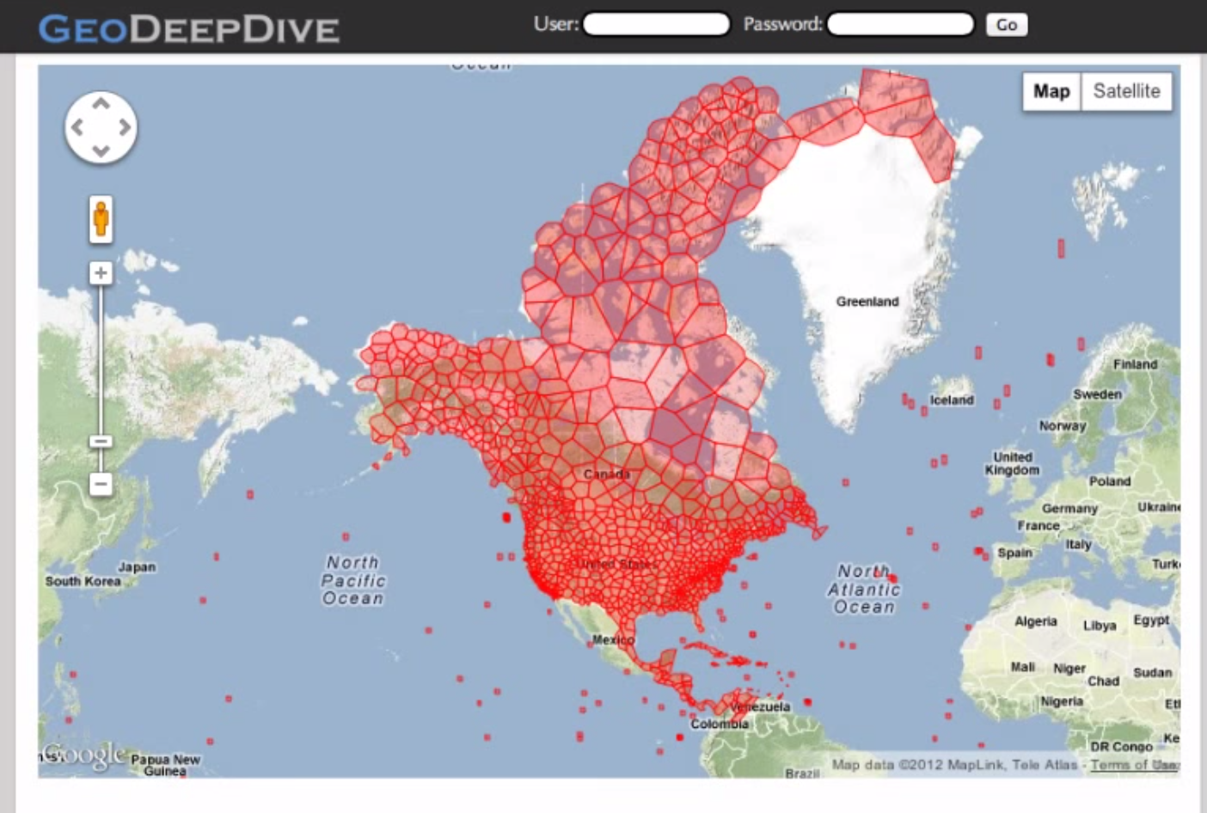
MEMEX – to track Human Trafficking Risks
Wisci(pedia) – Encylopedia built by machine
GeoDeepDive – Geo Search Engine

Slide 3
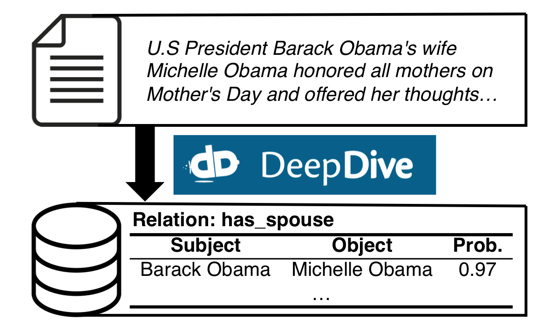

DeepDive Concept…

Slide 4
Other potential use case… Dodgy Dealings?
has_dodgy_dealing
Company X
Company Y

Slide 5
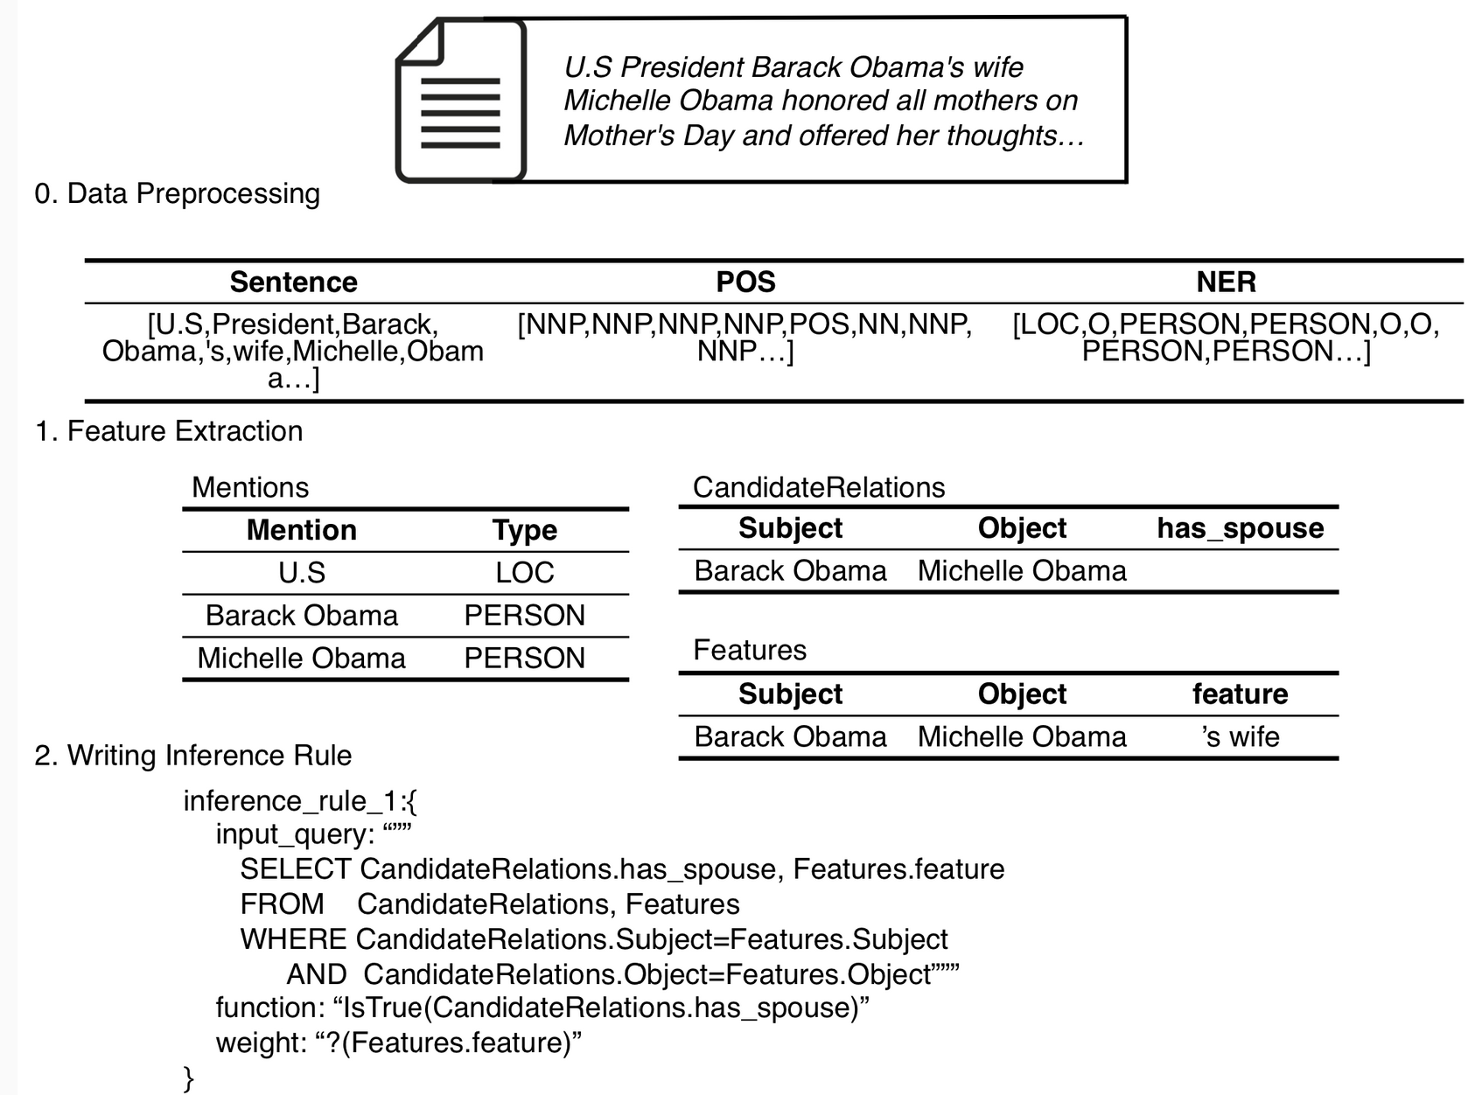
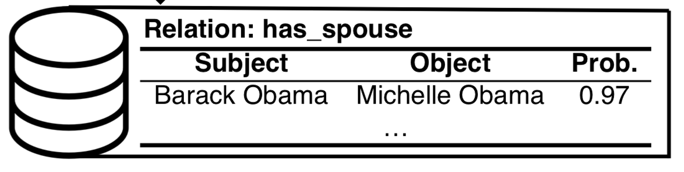
MVP1 – Try out DeepDive Spouse tutorial…
Heuristics
No husband-wife relationship
Joe Block <-> Joe Block
Daughter <-> Mother
Training
Existing Database
husband-wife relationship
Joe Block <-> Mary Block
No husband-wife relationship
Bob Builder
Victoria Sponge
Victoria Sponge
Joe Block <-> Ann Block

Slide 6
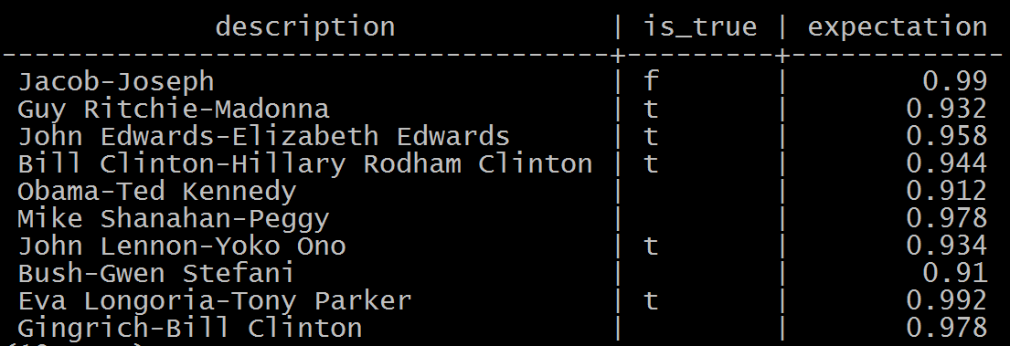
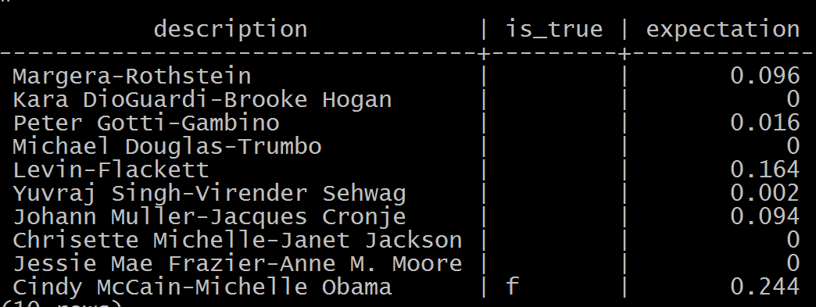
MVP1 – Try out DeepDive Spouse tutorial…
Freebase
??? Hmmm…..
Prediction
Huristics…

Slide 7

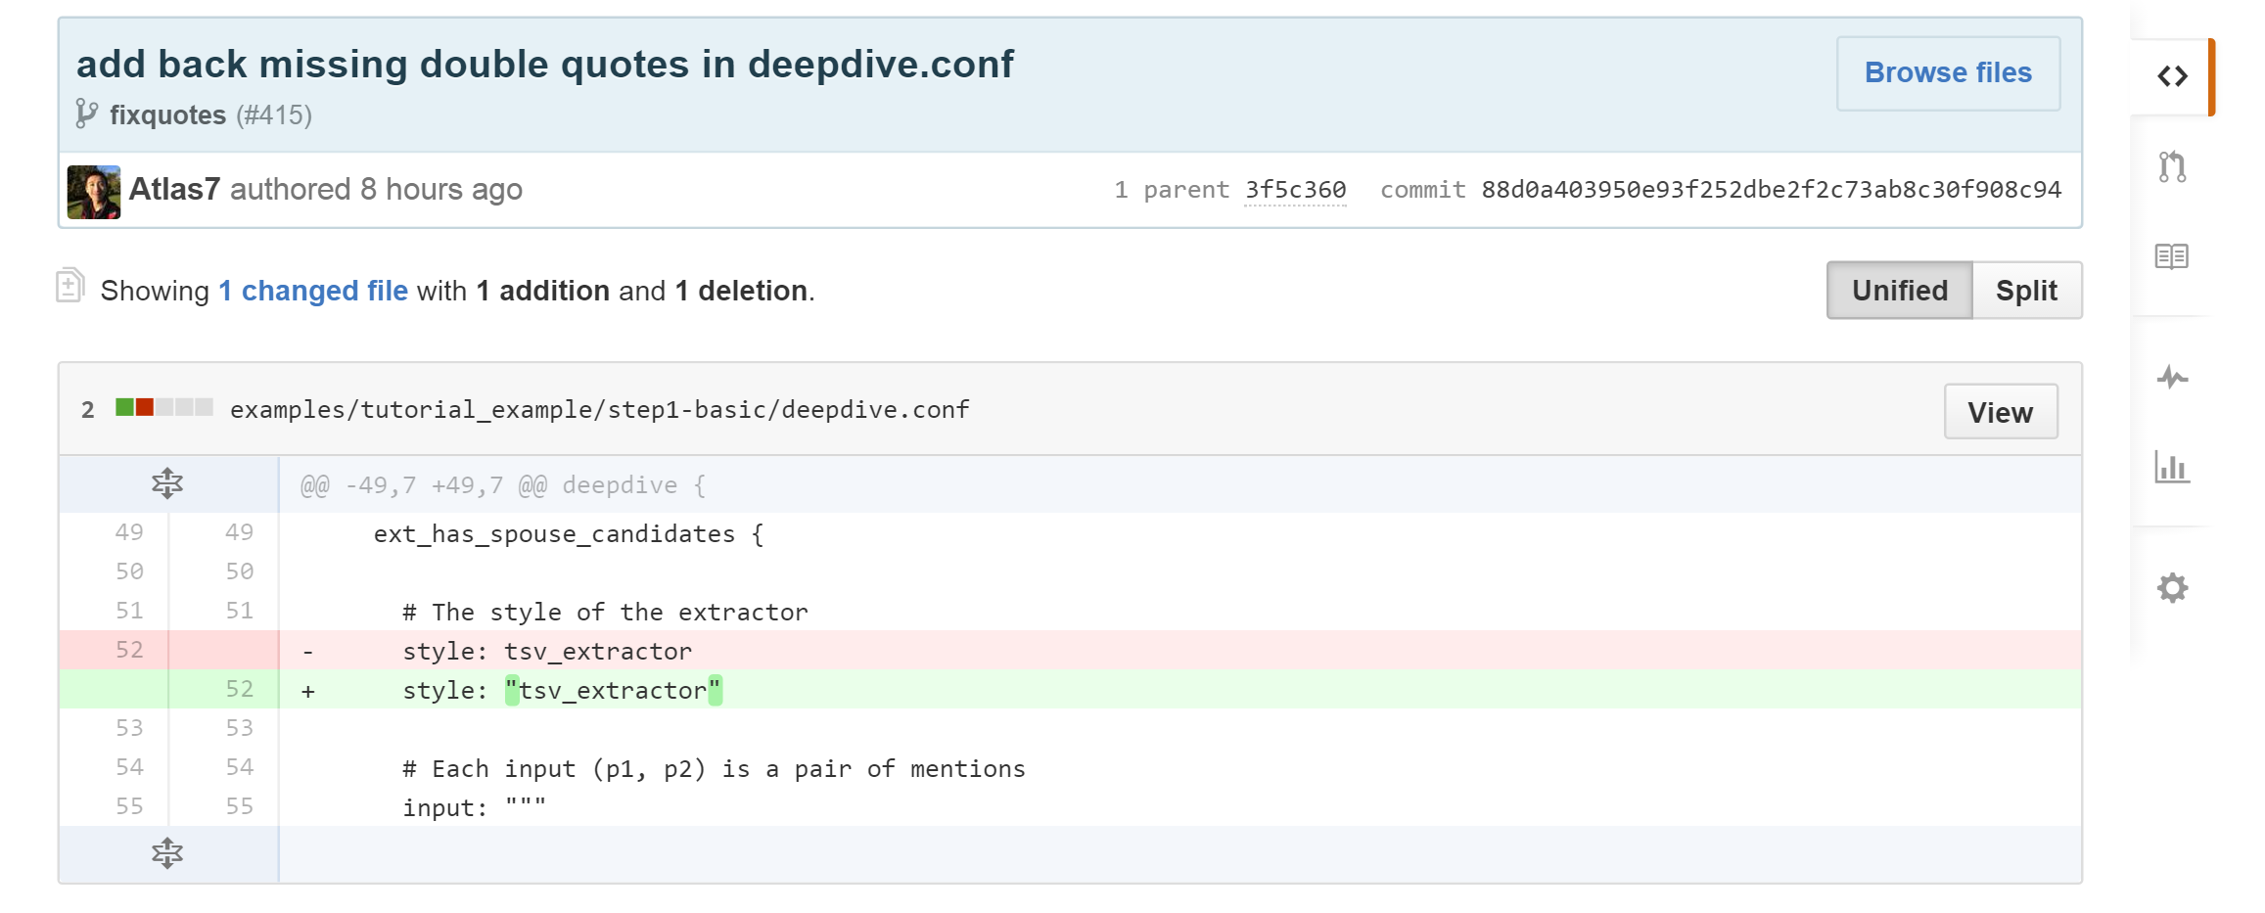
Contribution…
Fixed missing double quotes! ☺

Slide 8
For info: Vagrant VM (for future development)…
VirtualBox
Vagrant VM
Ubuntu/Trusty64
4 GB RAM
2 CPU
DeepDive
Python
PostgreSQL
https://github.com/atlantis2020/mini_deepdive
(Experimental Phase)

Slide 9
Team Atlantis – “Dodgy Dealing” Engine (with DeepDive)
Q&A
#MODHack | 25-27 September 2015 | WallaceSpace, London

